Slide 1
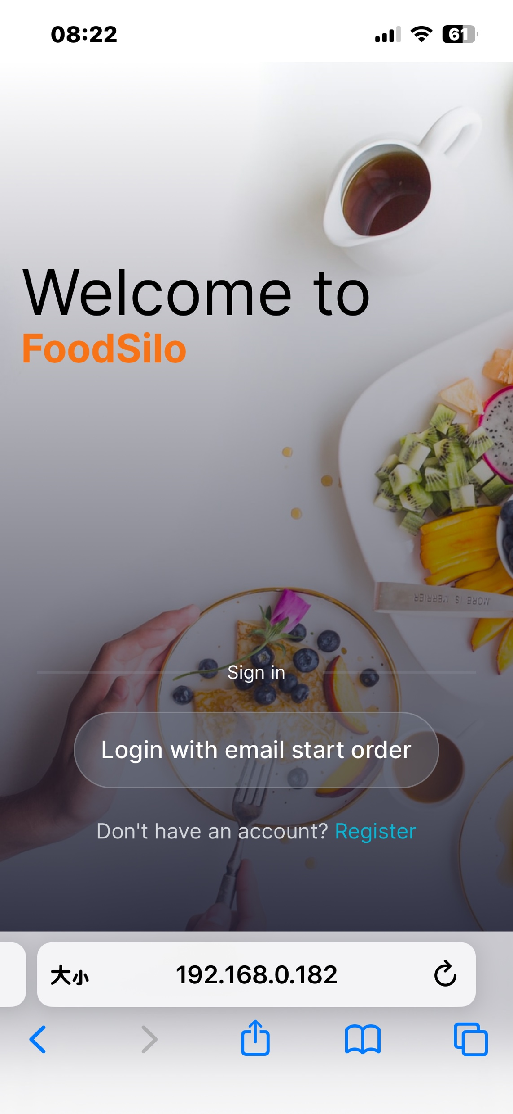
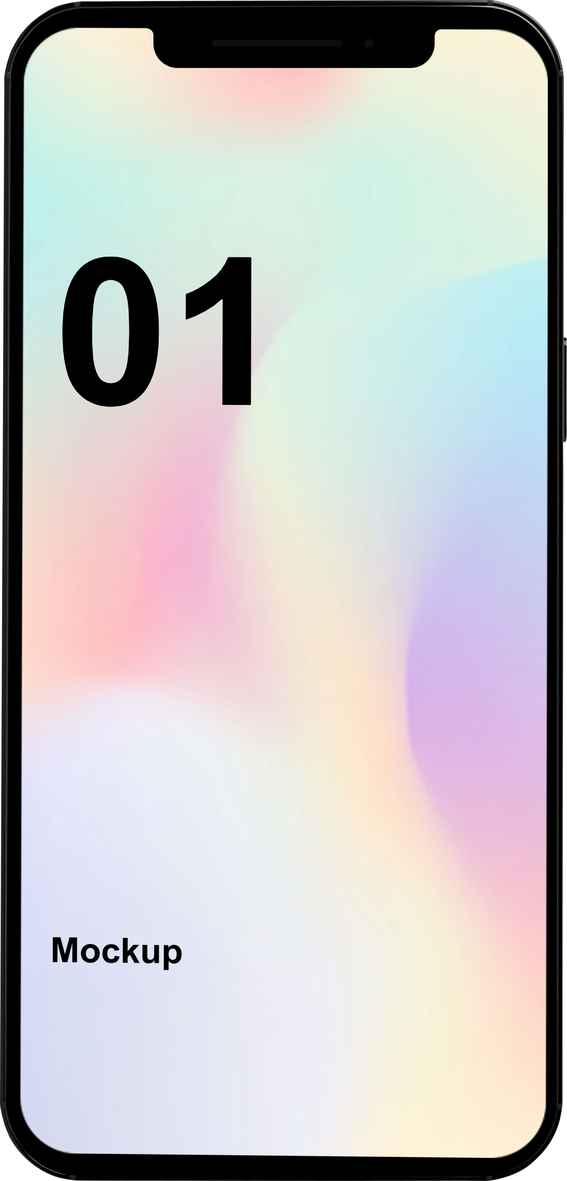
FOODSILO
Smart Ordering
in a restaurant
G10 / Strawberry dumplings

Slide 2
1
Topic Review
2
Prototype
3
Evaluation
4
Result

Slide 3
Topic Review
Give a brain to Search Engine,
and give an ears to ChatGPT
Implemented Functions
This Service aims to implement a Smart Ordering System. Explore the integration of Elasticsearch‘s search relevance capability with ChatGPT’s question-answering capability to do the smart recommendation for customers.
Highly intelligent menu search and recommendations through the collaborative use of ElasticSearch and ChatGPT, and a complete set of ordering processes (search, ordering, etc.)
User Target
Plan in future
Busy office workers
Students with fast-paced lives
Customers with a need for personalized service
People who feel uncomfortable with interpersonal communication
Connect the camera to enable code-scanning ordering.
Realize multi-person online coordinated ordering.

Slide 4
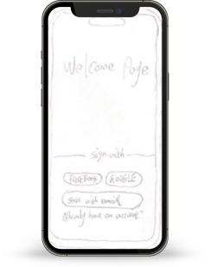
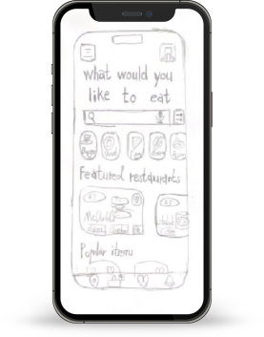
Start Plans: Paper Prototype
Basic structure of user interface:
Focus on the application's core functionality and key user processes like Login, Search, Browser, Order,....etc.

Slide 5
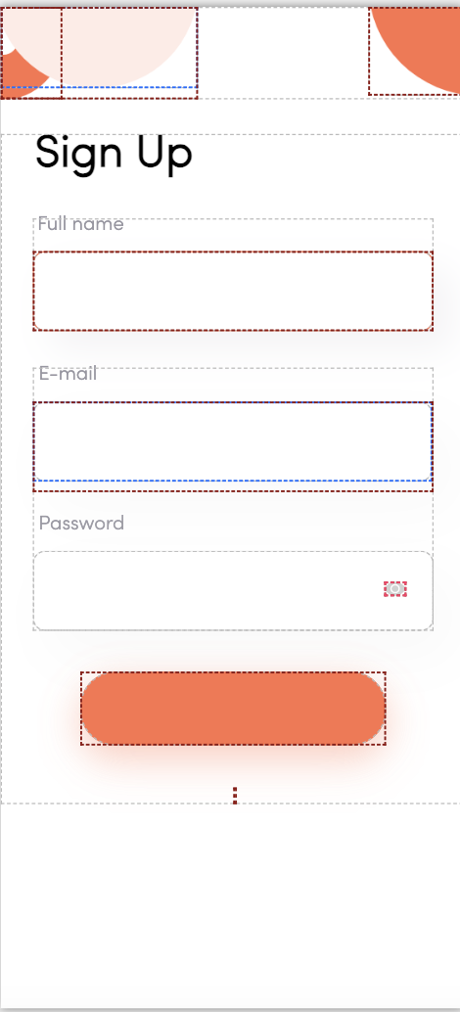
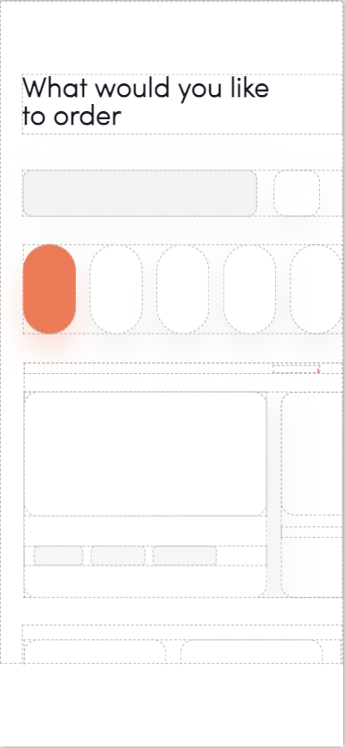
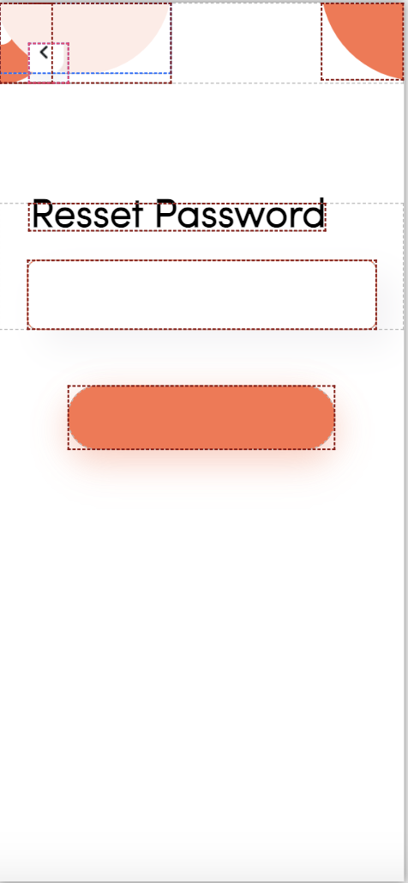
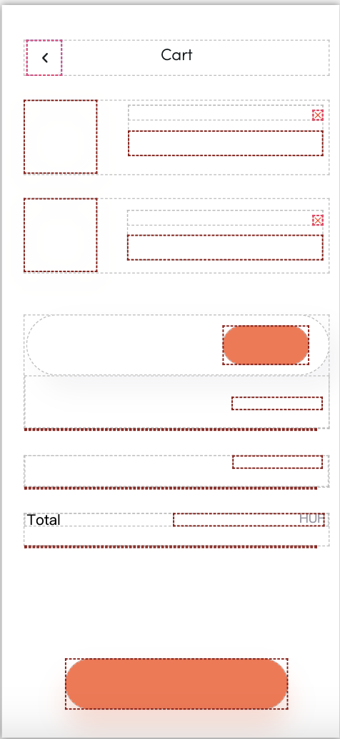
Digital prototypes (Low-fidelity prototype)

Slide 6

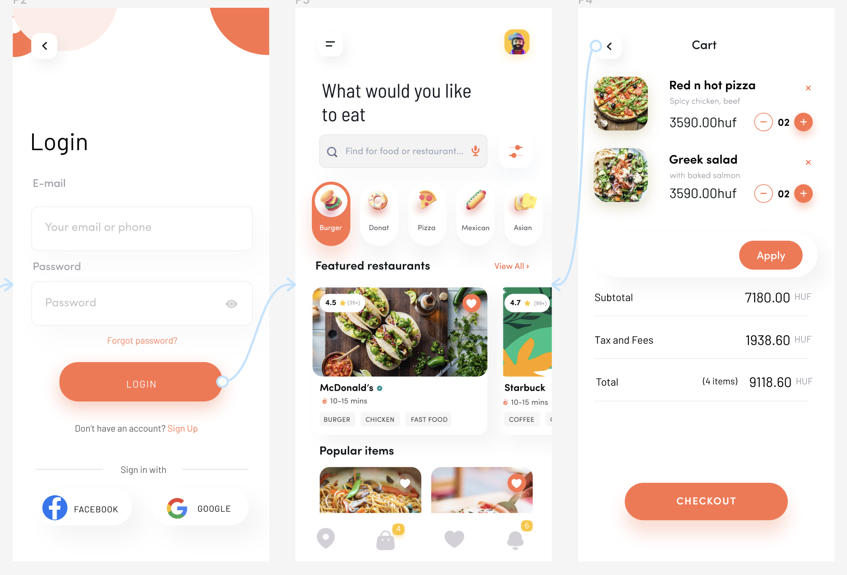


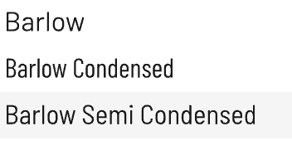

Digital prototypes (High-fidelity prototype)
Mainly design real graphics, colors, fonts and some interactive elements to be close to the user's final interactive experience and accurately present the look and feel of the final product.

Slide 7


Evaluation: Strategy
Purpose of Evaluation:
To gain a deeper understanding and analyze users' experience with the Smart Ordering System, identifying the system's strengths and potential weaknesses.
Gather user perceptions of the system's operability, functionality, and overall quality of service, which is critical for continuous product improvement.
Data Collection:
Detailed feedback and suggestions are collected using a variety of data collection methods, including direct user-rated surveys and open-ended questions.
These data will help to fully assess system performance from a technical perspective.

Slide 8
Evaluation: Plan
Composition of the evaluation team:
The evaluation team consisted of experienced smartphone users who were accustomed to using mobile applications for food service.
A total of eight users were selected as evaluators and supervised by team members.
Assessment content and preparation:
Software Version: The latest stable version of the smart ordering system.
Test devices: Conducted on Android and iOS platforms, mainly based on iPhone 13 models.
Task Cases: Focused on testing search and smart recommendation scenarios.

Slide 9

Evaluation: Plan --Test Cases
Task 1：Function Testing
--Fuzzy search with precise recommendations:
Task 2: Interactive Testing--Specific Needs Search
1. Evaluator voice or text searche for needs, i.e: "hot pot."
2. Evaluator views dish details based on the search results, including the add or delete items, check prices, and customized notes in the system
4. checks the interaction for accuracy.
5. Assess overall process smoothness and system response time.
1.Users voice-search(i.e. spicy dish) in app using our search button.
2.App suggests dishes in restaurant.
3.Evaluator selects dish but doesn't order.
4.Evaluate search accuracy, relevance, and voice recognition precision.

Slide 10
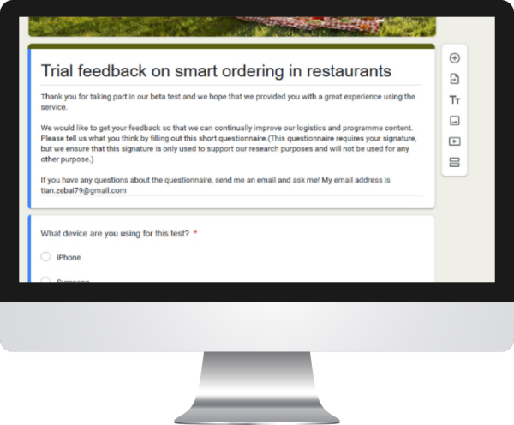
*Regarding user privacy and security, I have made a reminder at the beginning of the questionnaire to ensure that all information in this questionnaire is used for academic research only.
Evaluation: Plan
The questionnaire assesses screen fit, visual design, UI ease of use, order process efficiency, voice recognition accuracy, search and recommendation quality, and overall user satisfaction.
It also gauges the app's competitiveness in comparison to other software, gathering user suggestions for improvement.
Questionnaire address: https://docs.google.com/forms/d/1gRpavrhRGC0vWRFL2mKpK0t3m1OE77B3qkur_Sc1jNc/edit

Slide 11
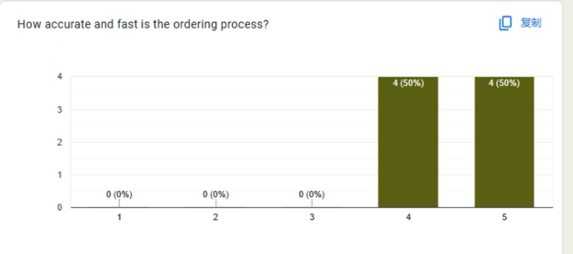
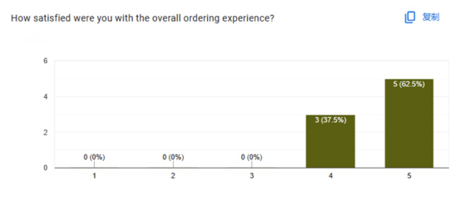
Evaluation: Results
Analyzing Information：
Pros:
Highly adapted to the iPhone screen
Beautiful interface
Order processing is fast and accurate
Shortcomings:
Voice function and smart search are not accurate enough
Main page and multi-language translation need to be improved

Slide 12
Evaluation: Results
——Based on the results obtained, we made the following changes.
Improve the speed and accuracy of order processing and optimize system back-end logic.
Evaluate and tune ElasticSearch and ChatGPT parameters to improve the relevance of search results.
Adjust and optimize the user interface.
Redesigned interface interactions in response to user-suggested navigational fluency issues.

Slide 13
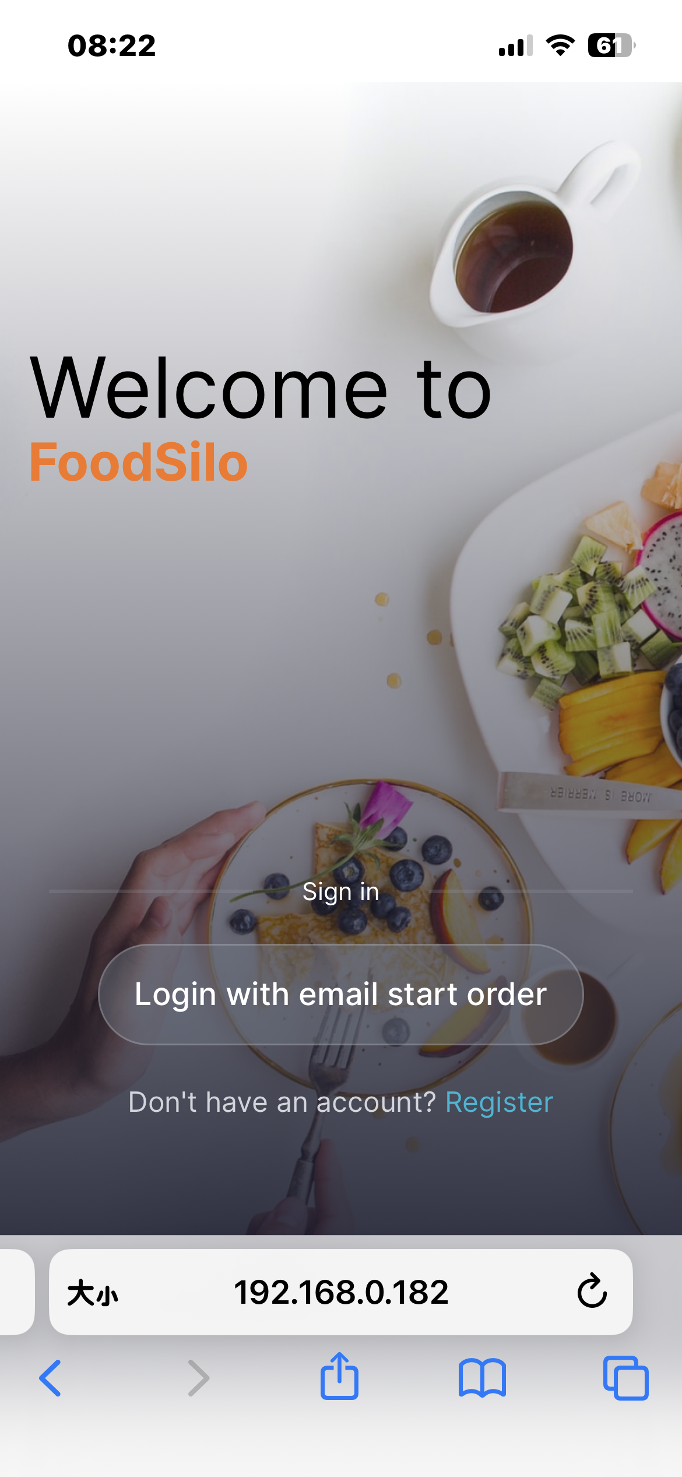
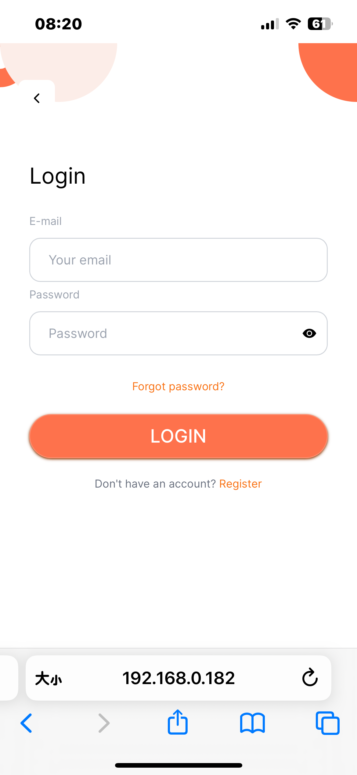
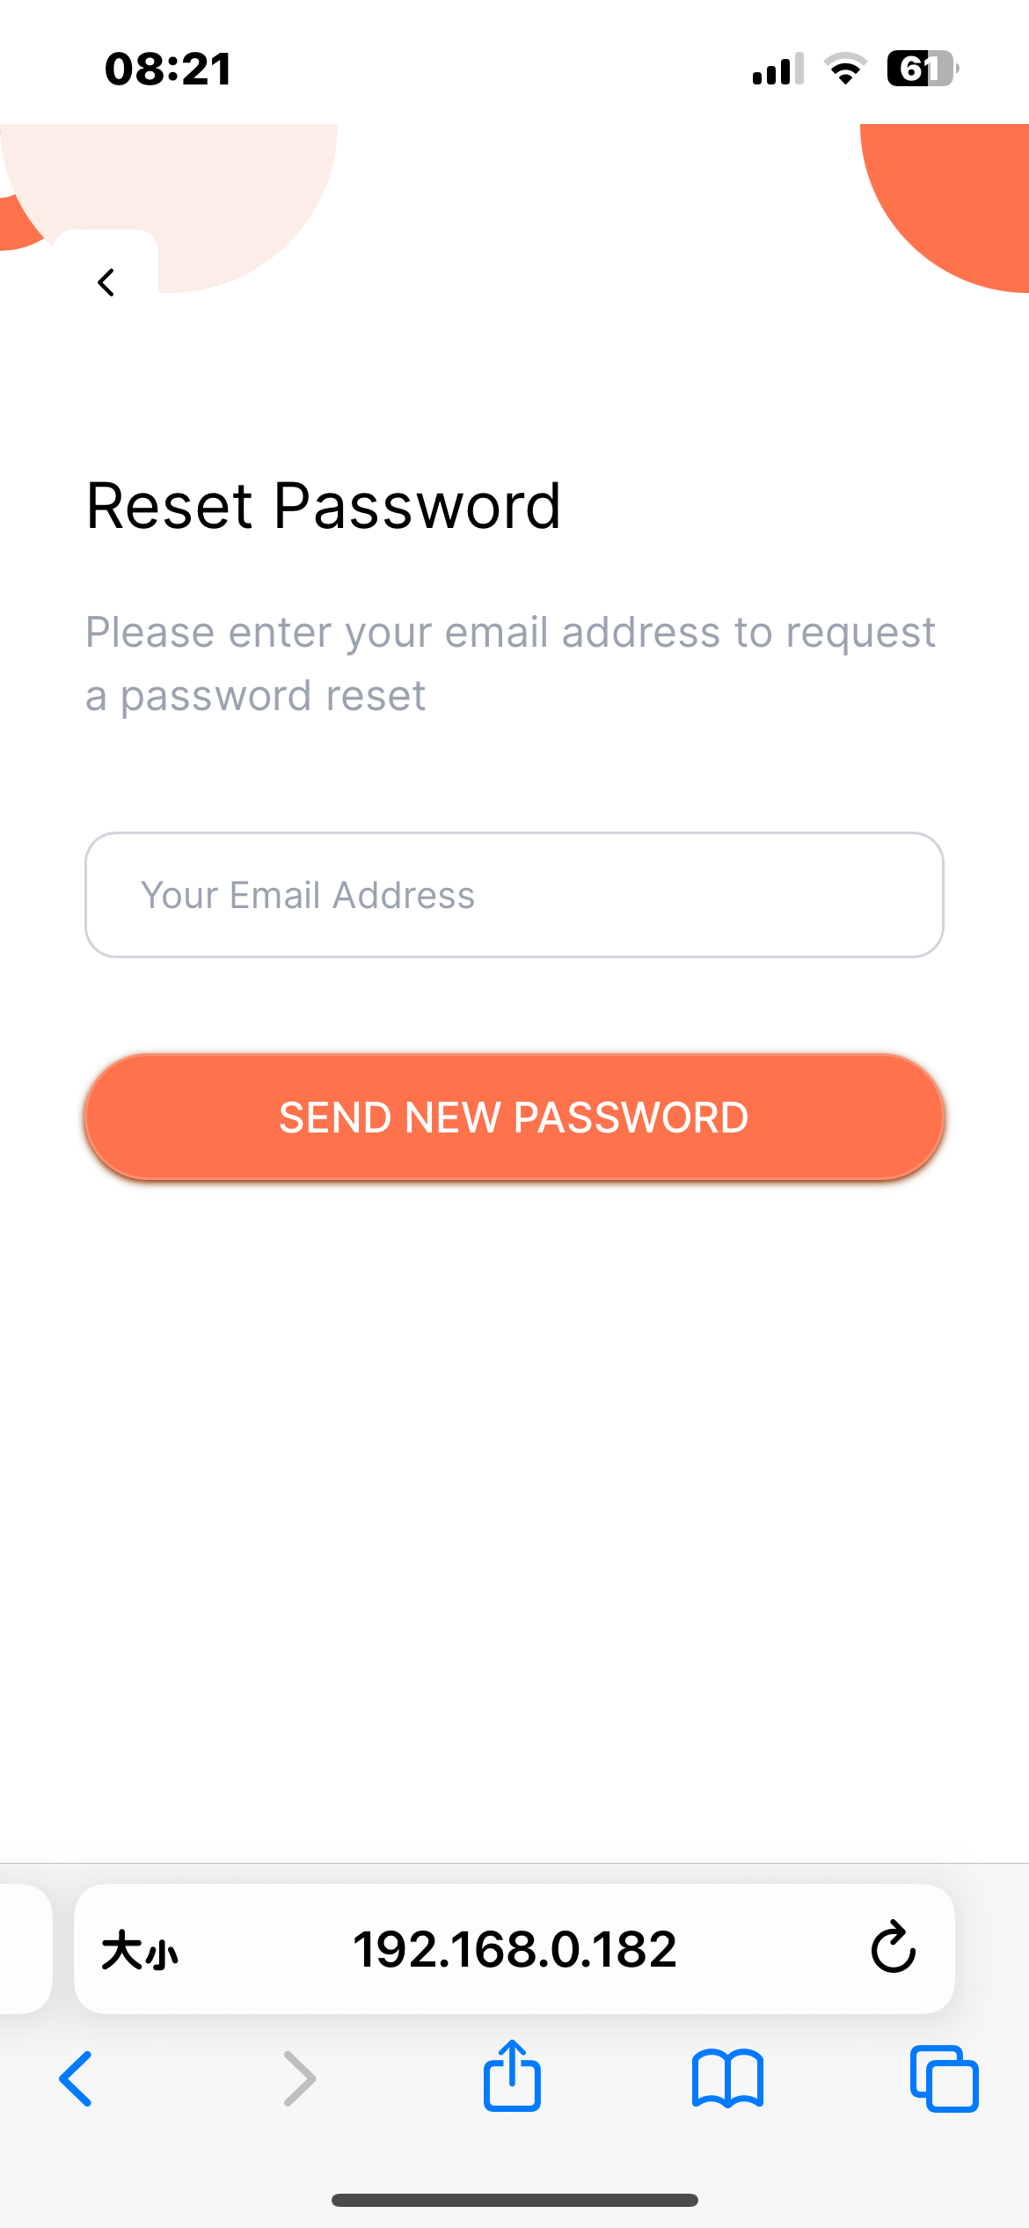
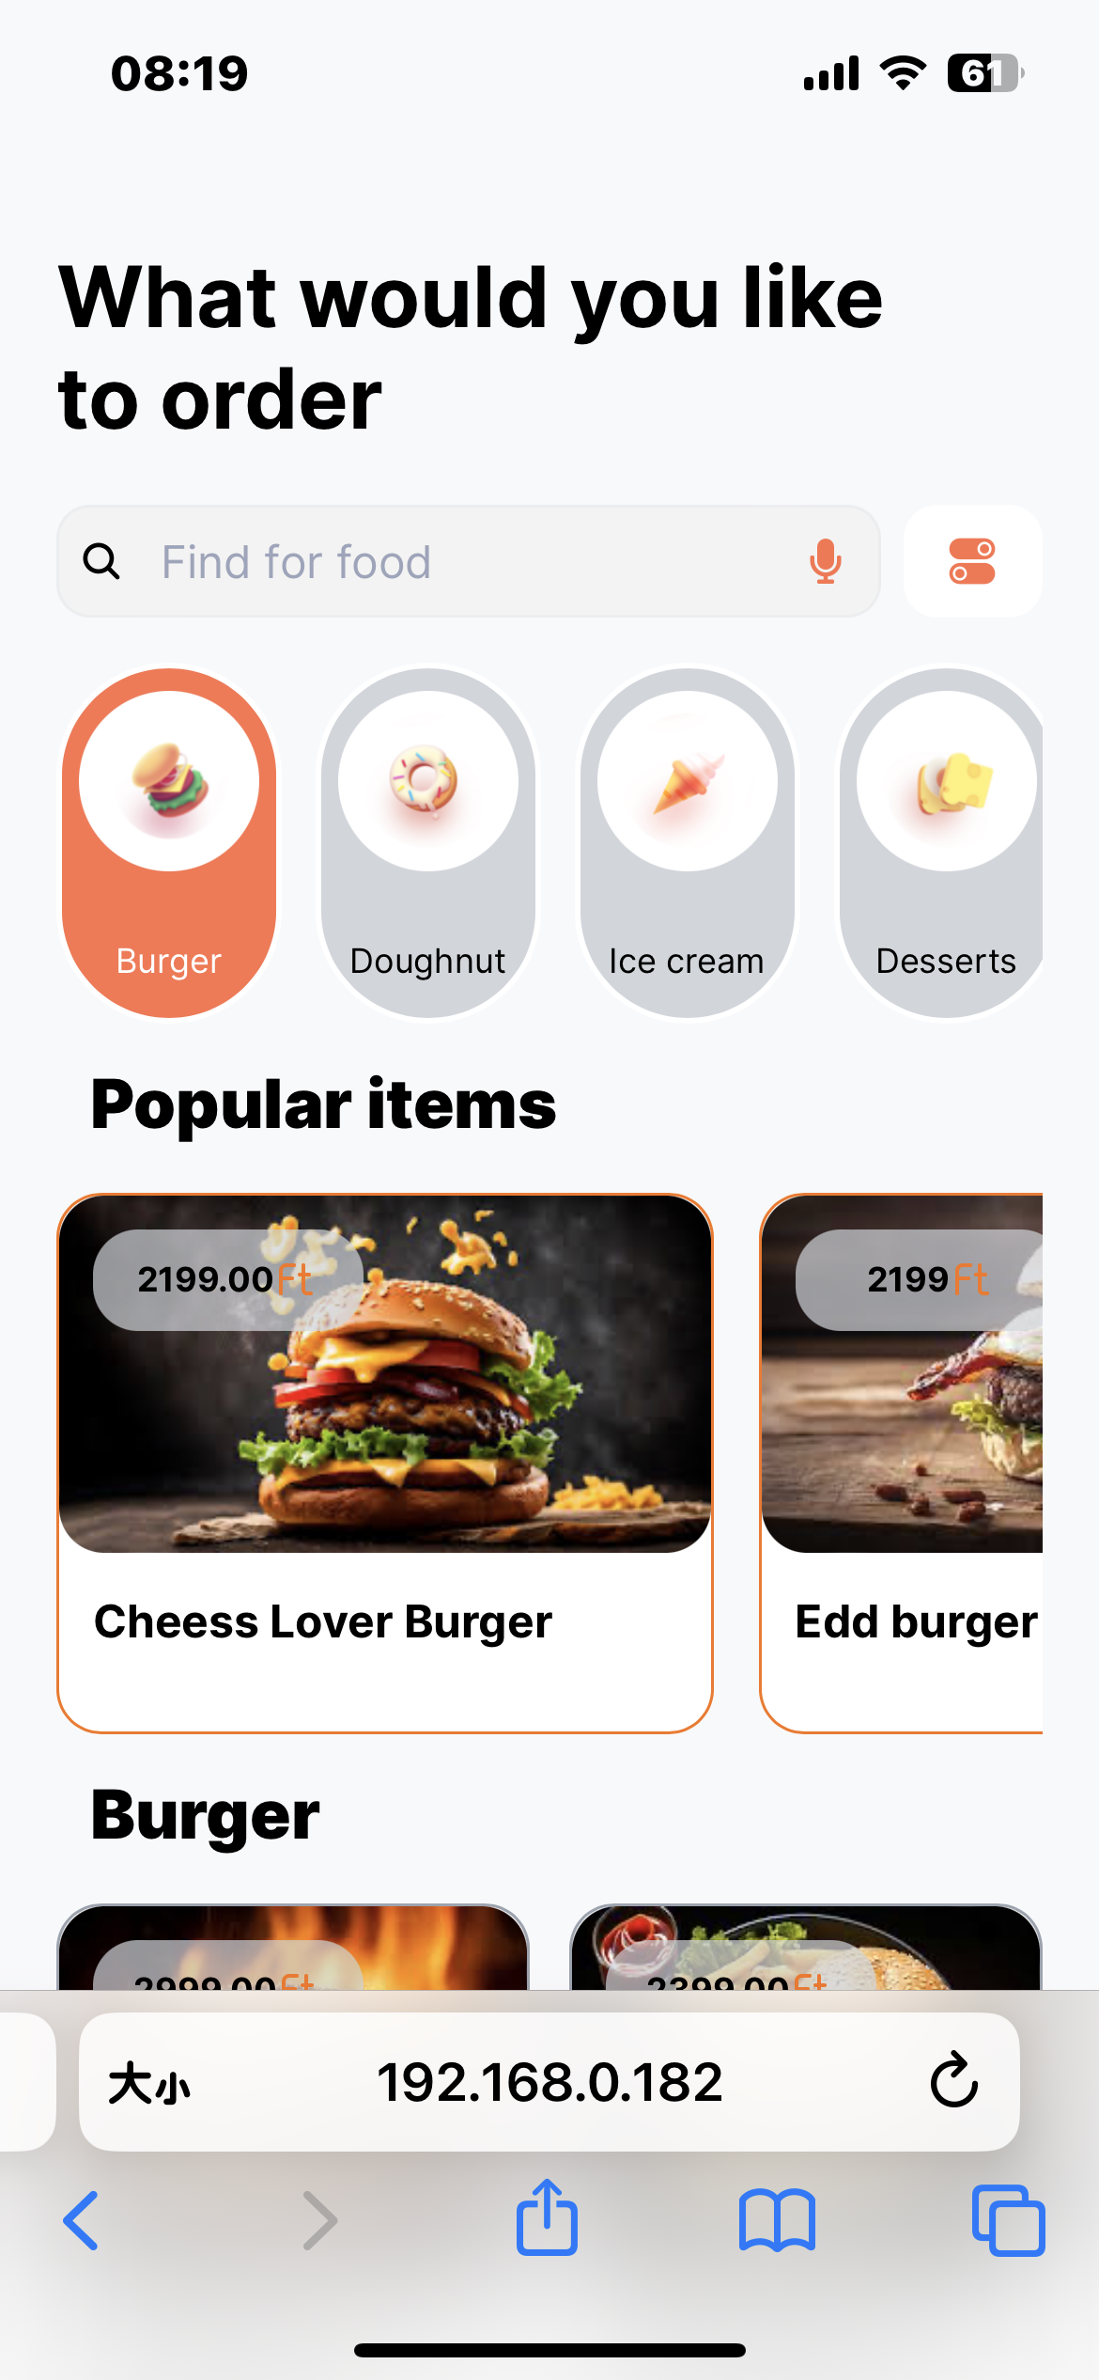
Partial Display

Slide 14
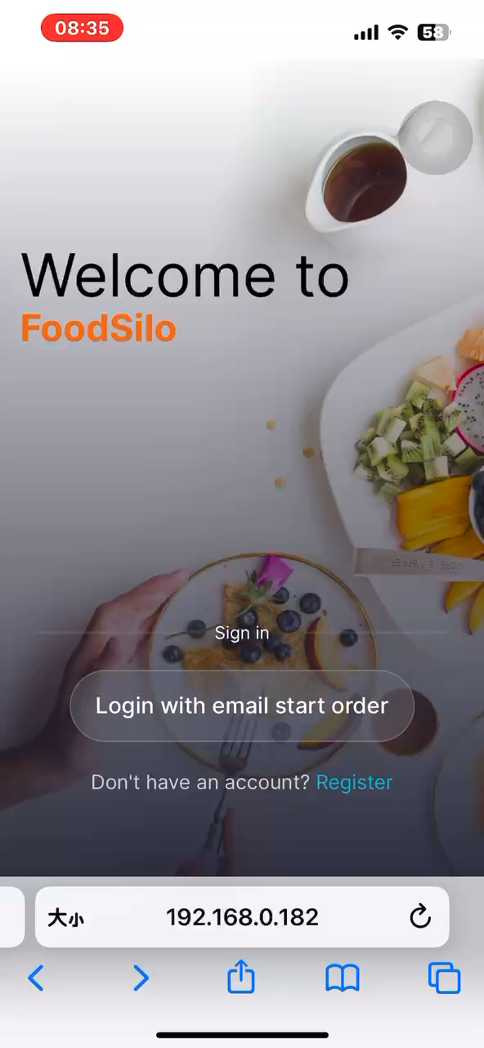
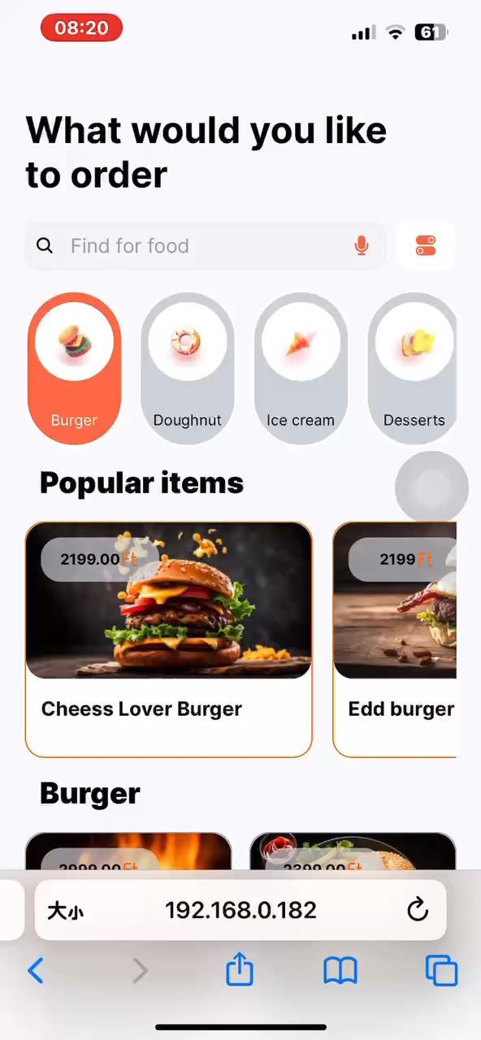
Partial Display

Slide 15
Thank you!
G10 / Strawberry dumplings
WANG Fei
CHEN Siyu
TIAN Zebai
by

